Slide 1
Rubik’s Cube Solver
Based on the book Mastering the Cube by Don Taylor
Aline “Lyn” Normoyle
www.alinenormoyle.com
@_madsquirrel
https://github.com/alinen/cube
Notes:
Hello All. My name is Lyn. I currently work as a game programmer and occasional lecturer in graphics and animation. Today, I want to talk about a Rubik’s cube solver that I’ve been working on.

Slide 2
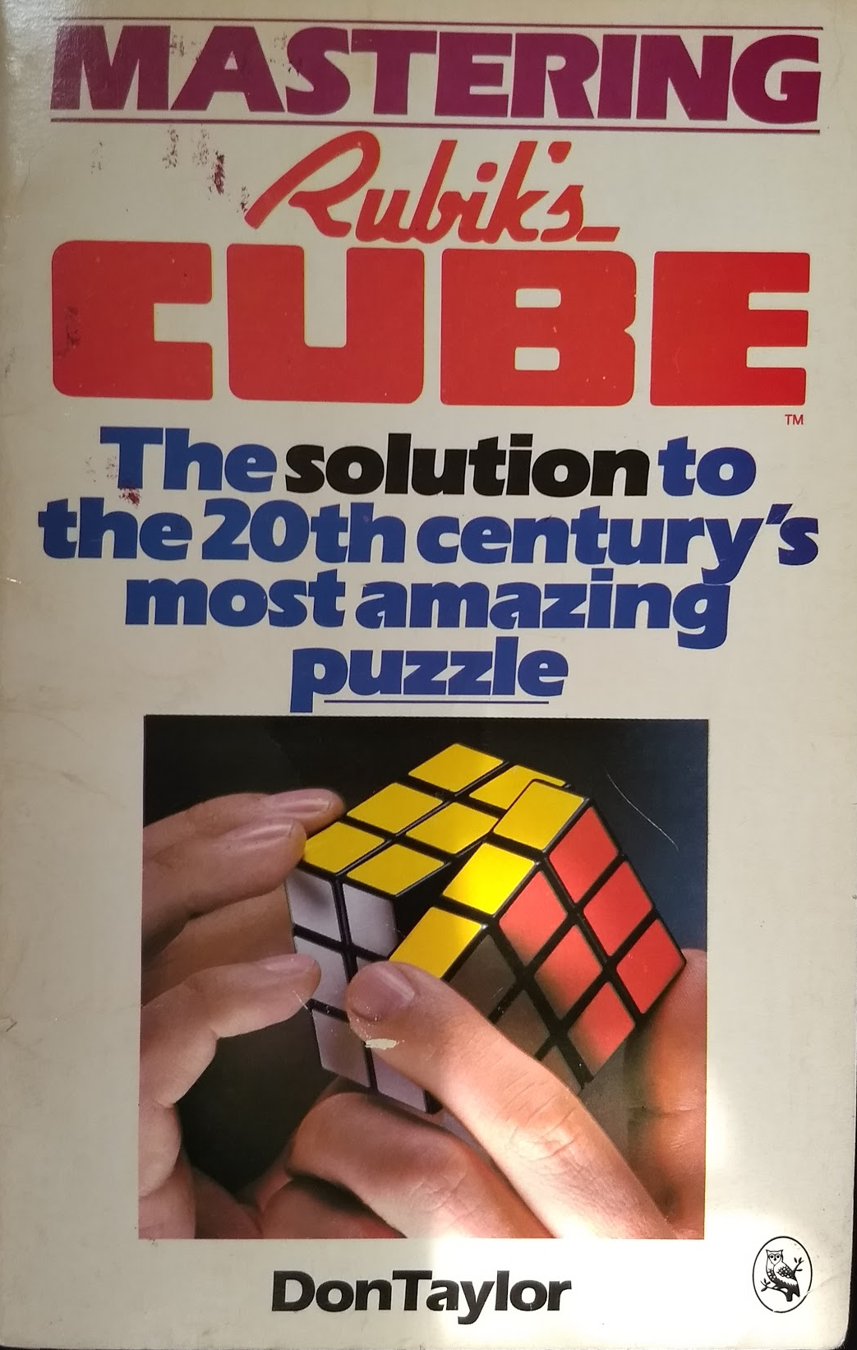
Why?
Simulate how a person would solve the cube
Working to create an interactive cube teacher
for practice
for learning new patterns
Not optimal (e.g. doesn’t use fewest moves) but that’s ok!
Notes:
Ask how many people know how ot solve the Rubik’s cube already. They would be familiar with this type of technique

Slide 3
Algorithm - Cookbook approach
Solve the cube from top row to bottom
Top middle
Top corners
Middle middles
Bottom corner positions
Bottom middle positions
Twirl bottom corners
Flip bottom middles
Notes:
This is different from guides you might read, which define moves relative to the viewer (e.g. turn the front face clockwise).

Slide 4
Algorithm - Cookbook approach
Solve the cube from top row to bottom
Top middle
Top corners
Middle middles
Bottom corner positions
Bottom middle positions
Twirl bottom corners
Flip bottom middles
For each task:
Select a cube (or cubes) to move
Search for move sequence
(NOTE: Search is easy because we only need to check a small subset of possible sequences)
Notes:
This is different from guides you might read, which define moves relative to the viewer (e.g. turn the front face clockwise).

Slide 5
Algorithm - Cookbook approach
Solve the cube from top row to bottom
Top middle
Top corners
Middle middles
Bottom corner positions
Bottom middle positions
Twirl bottom corners
Flip bottom middles
Notes:
This is different from guides you might read, which define moves relative to the viewer (e.g. turn the front face clockwise).

Slide 6
Algorithm - Cookbook approach
Solve the cube from top row to bottom
Top middle
Top corners
Middle middles
Bottom corner positions
Bottom middle positions
Twirl bottom corners
Flip bottom middles
Notes:
This is different from guides you might read, which define moves relative to the viewer (e.g. turn the front face clockwise).

Slide 7
Algorithm - Cookbook approach
Solve the cube from top row to bottom
Top middle
Top corners
Middle middles
Bottom corner positions
Bottom middle positions
Twirl bottom corners
Flip bottom middles
Notes:
This is different from guides you might read, which define moves relative to the viewer (e.g. turn the front face clockwise).

Slide 8
Algorithm - Cookbook approach
Solve the cube from top row to bottom
Top middle
Top corners
Middle middles
Bottom corner positions
Bottom middle positions
Twirl bottom corners
Flip bottom middles
Notes:
This is different from guides you might read, which define moves relative to the viewer (e.g. turn the front face clockwise).

Slide 9
Algorithm - Cookbook approach
Solve the cube from top row to bottom
Top middle
Top corners
Middle middles
Bottom corner positions
Bottom middle positions
Twirl bottom corners
Flip bottom middles
Notes:
This is different from guides you might read, which define moves relative to the viewer (e.g. turn the front face clockwise).

Slide 10
Algorithm - Cookbook approach
Solve the cube from top row to bottom
Top middle
Top corners
Middle middles
Bottom corner positions
Bottom middle positions
Twirl bottom corners
Flip bottom middles
Notes:
This is different from guides you might read, which define moves relative to the viewer (e.g. turn the front face clockwise).

Slide 11
Algorithm - Cookbook approach
Solve the cube from top row to bottom
Top middle
Top corners
Middle middles
Bottom corner positions
Bottom middle positions
Twirl bottom corners
Flip bottom middles
Notes:
This is different from guides you might read, which define moves relative to the viewer (e.g. turn the front face clockwise).

Slide 12
Thanks!
Ongoing work is to experiment
with different visualizations
with camera controllers
Questions?
Notes:
This is different from guides you might read, which define moves relative to the viewer (e.g. turn the front face clockwise).

Slide 13
Cube moves
F, F’, F2 - rotate front face clockwise, counterclockwise, or 180 (+X)
B, B’, B2 - rotate back face clockwise, counterclockwise, or 180 (-X)
U, U’, U2 - rotate up face clockwise, counterclockwise, or 180 (+Y)
D, D’, D2 - rotate down face clockwise, counterclockwise, or 180 (-Y)
L, L’, L2 - rotate left face clockwise, counterclockwise, or 180 (-Z)
R, R’, R2 - rotate right face clockwise, counterclockwise, or 180 (+Z)
TODO: Interactive demo
Notes:
This is different from guides you might read, which define moves relative to the viewer (e.g. turn the front face clockwise).

Slide 14
Additional references
http://kociemba.org/cube.htm
http://www.cs.brandeis.edu/~storer/JimPuzzles/RUBIK/Rubik3x3x3/READING/WikipediaSolutions.pdf (wikipedia?)

